Slide 1
ISBPM_Assignment_8.2- Experiment 8: Subscription plan optimization for a streaming service

Slide 2
Product Offering-Objective
Rolling out Subscription plan –for a streaming service . To measure the market effectiveness and calculate potential the company is doing a conjoint analysis . There are 5 brands in Play and below are the list of Features which are needs to be analysed to find out which brand is delivery value and which attribute is the deciding factor when consumer choice is concerned to subscribe for the Streaming service
Video streaming subscription
Base Features
Download shows on the go
Includes Live TV
Bundle with other subscription services
Share account with Family members
Price per month

Slide 3
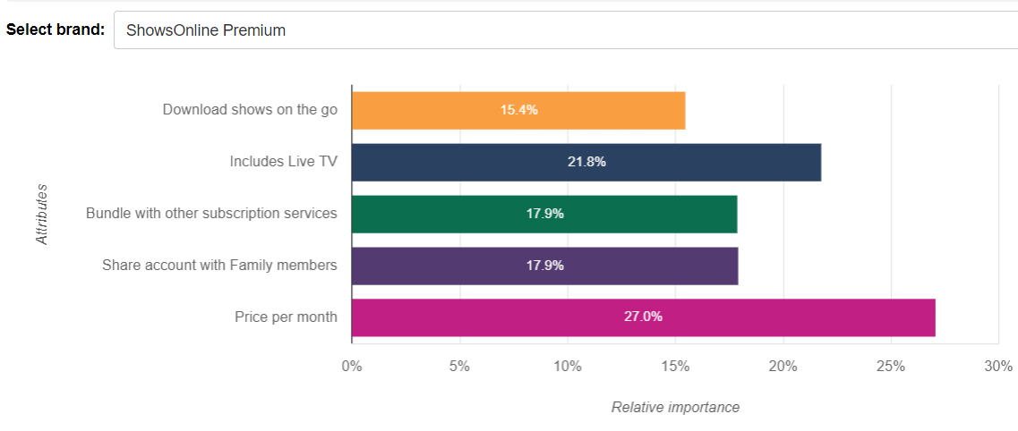
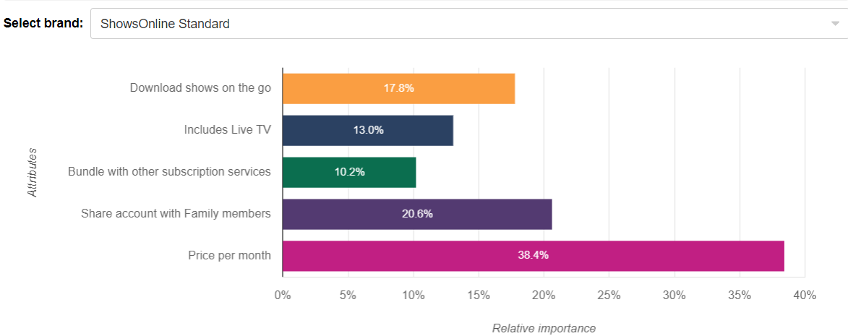
Feature Prioritization
FEATURE IMPORTANCE
The feature importance graph displays the influence a feature has when the respondent is choosing their preferred bundle. The higher the score, the more weight it carries in the decision-making process. This table compares each of your features’ importance. This chart shows the relative importance of Price Per Month as it carries the maximum weightage for both the brands

Slide 4
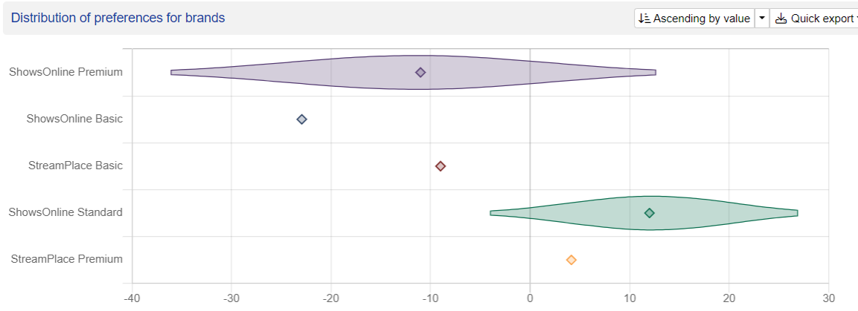
Brand Preference
ShowsOnline Premium and ShowsOnline Standard are 2 brands being in the market of online streaming has the equivocal market share and eyeing to penetrate the new market trends .based on the study it has been found ShowsOnline Premium has been the most preferred brand as per viewer’s choice . StreamPlace Basic is the least which consumers want to go for

Slide 5
Response Declutter
Currently the Indian market Repsonse regrading the streaming service where it has been found the low cost and service swhich matters most

Slide 6
Response Declutter -West
US response is quite interesting as they are going for value for money

Slide 7
Discussion Point 1- Concept ranking
ShowsOnline Standard –Streaming is rolling base feature which has struck the chord with the Consumers. The first thing which has worked on the mindset is the price they are charging .They have kept the price under 8 $ . What they have offered with their standard service sis value for money. They have included live TV inside the package and bundled with other subscription services. Customers don’t have to buy other package with extra cost and can avail basic features along side Live TV. What every customers want always to share account with family members so that they don’t have to subscribe individually ShowsOnline Standard Rollout product is offering them account sharing and download on the Go. Most of the millennials love this offering as they don’t have time to browse different packages rather they want everything bundled and cost effective . LiveTV is something which has been successful in the west and now peaking fast in india. So as per the concept ranking its has become highly attractive offer

Slide 8
Discussion Point 2 –Turf Analysis
Based on the below Turf analysis – 95 % people have understood the survey and expressed to recommend the product .The price is the attribute which has captured their preference . With this portfolio, 95% of all customers can be reached. Of these, on average everyone likes 1.62 of the varieties offered (Frequency) and will most likely recommend. Next With this portfolio, 94% of all customers enjoy the product offering. Of these, on average everyone like 1.53 of the varieties offered (Frequency) and undertood the survey. With this portfolio, 76% of all customers can be reached. Of these, on average everyone likes 1.63 of the varieties offered (Frequency) and will mostly recommend this survey

Slide 9
Discussion Point 3 –Preference Of levels
Download shows on the go has shown better preference of 75 %. High positive values mean relatively high preferences. Negative values mean relative dispreference . On Average Download shows on go has garnered high preference .8.6 % Consumers are ready to spend 11 $ on month average for Premium Offering. The most preferred level around the ShowsOnline premium is LiveTV followed by shared account with following members.Around 11.6 % voted for Live TV where 11.5 % voted for Share Account with family numbers
In case of regular Subscription Model 12.5 % consumers prefer to pay 5 $ a month. 63.6 % consumers expressed their preference for Download on Go. For both Premium and Regular subscription offering Download shows on the Go is a preferred level. 5- 12.5 % consumers want a price around 5-7 $ per month. The next preferred level as per the Regular subscription model is Share Account with family numbers where 11 % has voted for it under regular Model.
Brand | Attribute | Level | Average preferences for levels
ShowsOnline Standard | Download shows on the go | Download shows on the go | 0.11190942
ShowsOnline Standard | Download shows on the go | None_Download | -0.11190942
ShowsOnline Standard | Includes Live TV | Includes Live TV | 0.08405977
ShowsOnline Standard | Includes Live TV | None_LiveTV | -0.08405977
ShowsOnline Standard | Bundle with other subscription services | Bundle with other streaming services | 0.04821104
ShowsOnline Standard | Bundle with other subscription services | None_Bundled | -0.04821104
ShowsOnline Standard | Share account with Family members | Share account with family members | 0.11130263
ShowsOnline Standard | Share account with Family members | None_accountshare | -0.11130263
ShowsOnline Standard | Price per month | $5/Month | 0.12486006
ShowsOnline Standard | Price per month | $7/Month | 0.03931416
ShowsOnline Standard | Price per month | $9/Month | -0.16417422
Where we can see premium Model – Consumers prefer Live TV vis-avis – download on Go in regular Model.But what common is in both segments consumers want to share account with consumers and price 5-11 $ which they are ready to spend

Slide 10
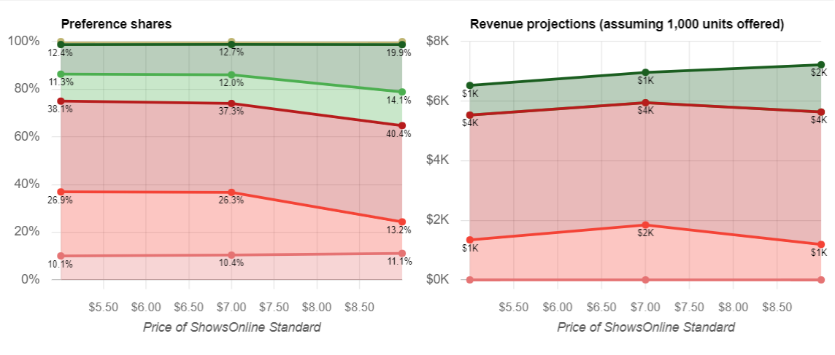
Discussion Point 4 –Sensitivity to price
Showsonline –premium has the highest share in the market with 36 % whereas ShowsOnline regular has 26.3% market share .Lowest been the basic package which is 10.4 % what it shows is the consumers preference is for LIveTV ,DownLoad on Go and share account with family memebers.These 3 features are of high demand and attracting the segment.What is interesting here is with 9 $ a month “StreamPlace Premium” which is rolled out with premium features but misses on top 3 attributes still posting a revenue generation of 1588K compared to ShowsOnline –regular which is providing download on Go but still people don’t want to pay 9$ for regular which comes with account sharing and Download on Go. Mostly company revenue depends on Shows Online premium which has gather around 4188-4443 K while price varies from 5$-9$ . For ShowsOnline-regular consumer is ready to pay 5$ a month and for premium 9 $ which is their preferred bracket . Consumers wants to enjoy premium features where they can opt out of Download and Go and rather subscribe for bundled out package

Slide 11
Discussion Point 5-Feature Selection
The product offering based on Optimal package and base Line package has a staggering differences . While we remove account sharing – ShowsOnline=premium is still having a revenue of 4000K. But consumer preferring Baseline package on average more than Optimized package .They want addons on base package . In case of Optimal package consumer going for download feature and can agree on removing Live TV . On baseline both premium and regular has been less preferring Account sharing feature . Revenue is more consolidating while adding live Tv feature and discarding Bundle feature .On Average LiveTv is a feature which is preferred across base line rollout of all the brands. In case of Optimal package – ShowsOnline –regular Consumers prefer Account sharing feature as it has been found consolidating revenue .For ShowsOnline-premium –In optimal package removing Live TV is something which consumers are preferring while selecting feature. Removing Live TV is skyrocketing the revenue to 5288 K in Current portfolio of Optimal Package . While baseline portfolio- ShowsOnline-premium-removal of Account sharing is shooting revenue to 4103 K . For ShowsOnline-regular User just want the Baseline package to work. With baseline package they are generating a revenue around 2500K. So User preference changes to price sensitivity. The base line package been a hit across ShowsOnline-regular while Account sharing removal works for Premium .But in optimal package Users are looking for ShowsOnline-Standard to add Account sharing feature But ready to remove Live TV when they want to buy premium again price sensitivity comes into picture. When prices are higher side generally consumers want to share and may give up on features that are cosmetic attributes. With base line they can opt for LiveTv since price is still within their budget .

